Slide 1
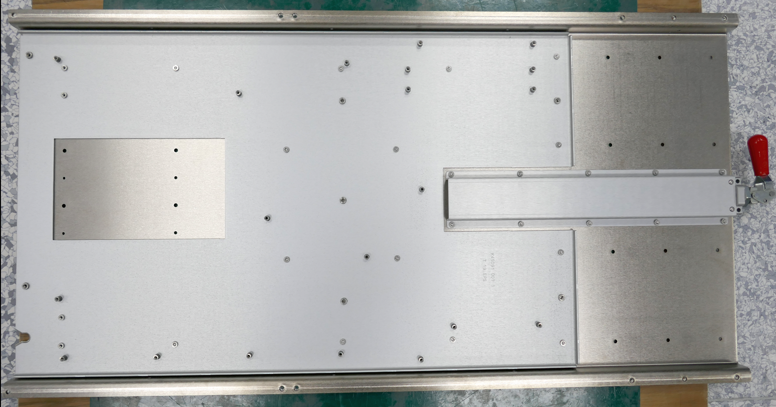
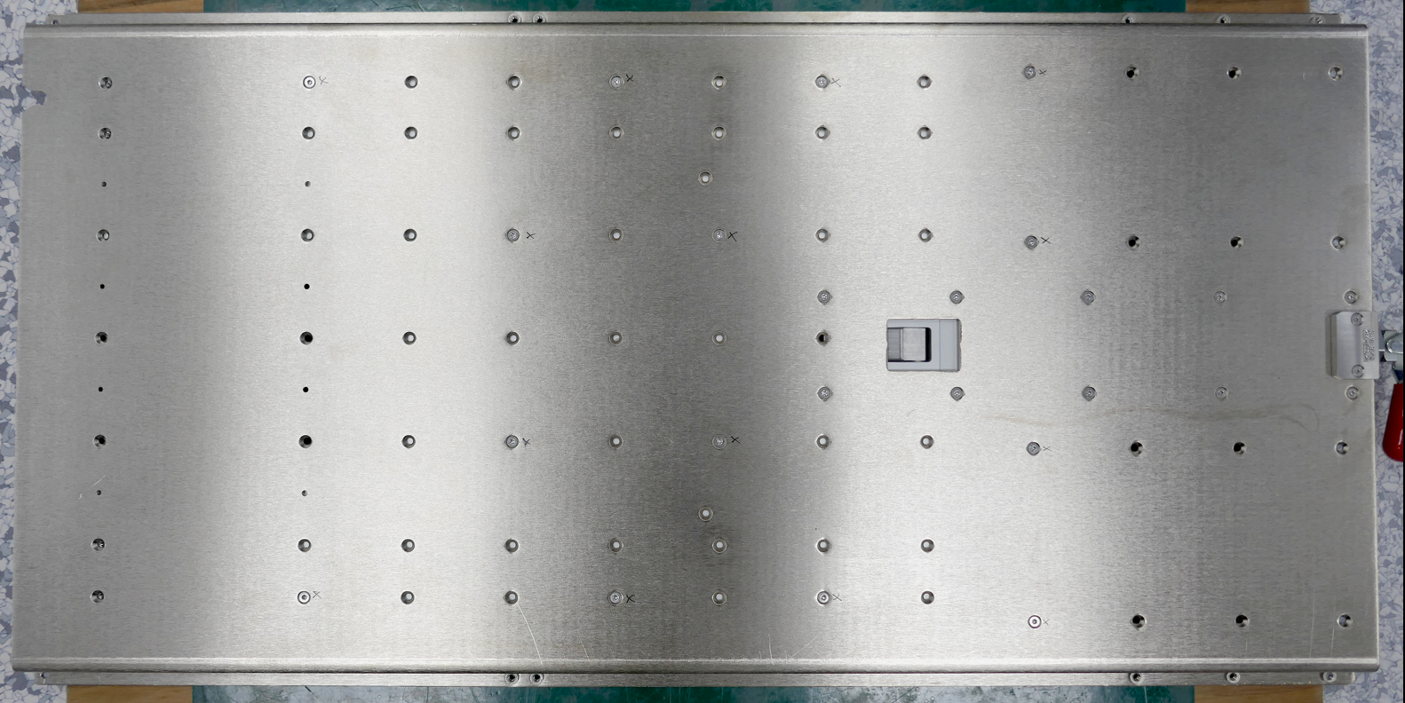
MB Pan Assembly
Top Side
Bottom Side
4
14
16
2
8
10
17
18
12
11
15
13
9
7
1
5
6
3
Initial secure the plate with 4x screw A53036-001. This is to prevent from the plate drop before flip over.
Flip over the MB Pan and tighten the from the bottom side using 14x screw A53036-001 torque 4in-lbs.

Slide 2
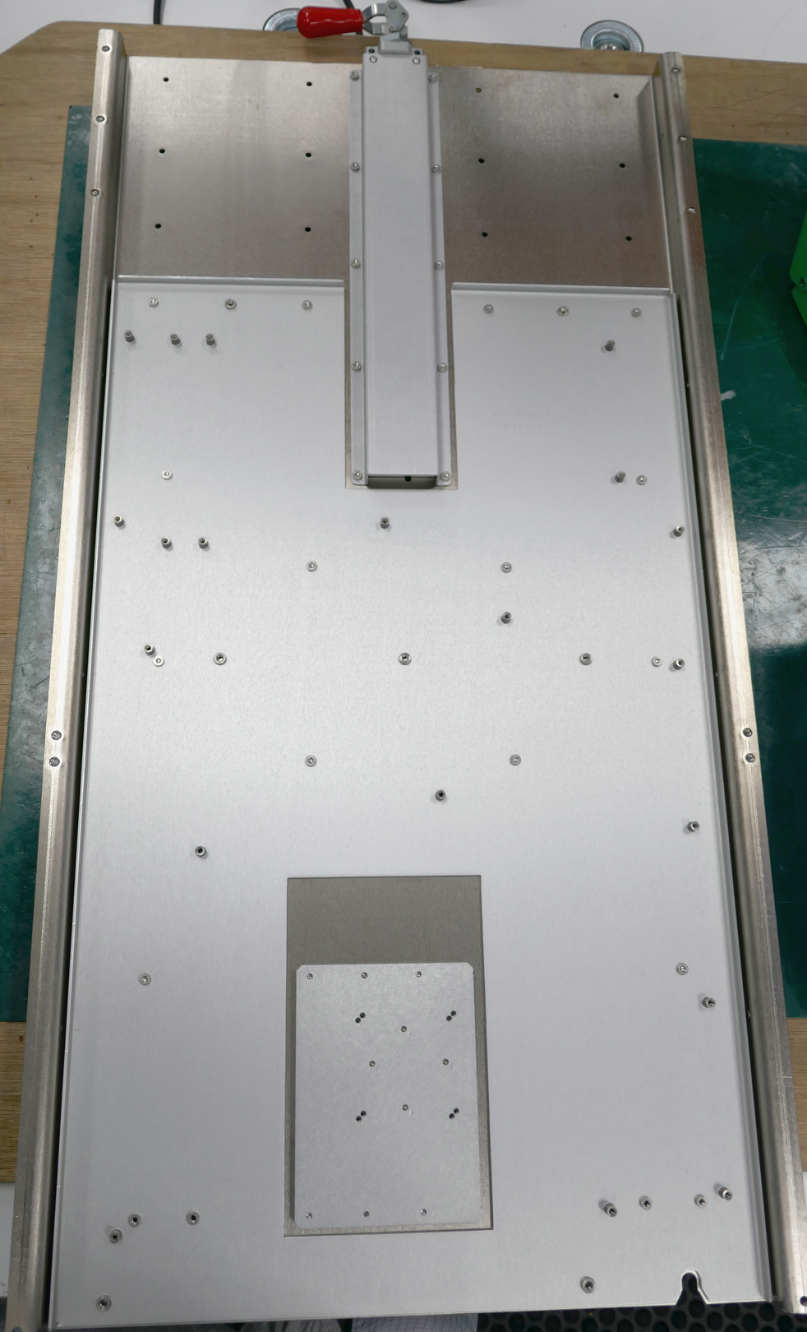
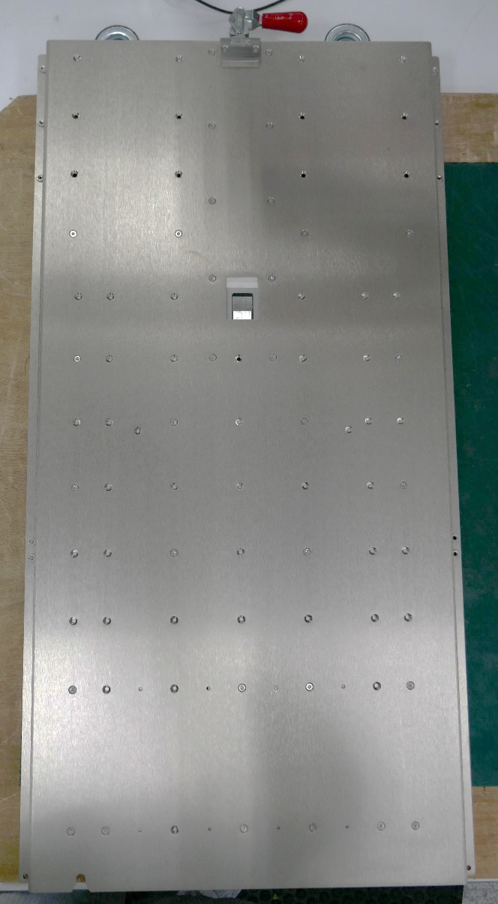
MP Pan Assembly
1
Install Datum block conversion J21650-002 into MB Pan as shown. Check Dowel pin orientation during installation.
3
2
2
1
4
2. Turn bottom MB Pan H19123-005, install 4x screw A53036-001 torque 4in-lbs as figure show.

Slide 3
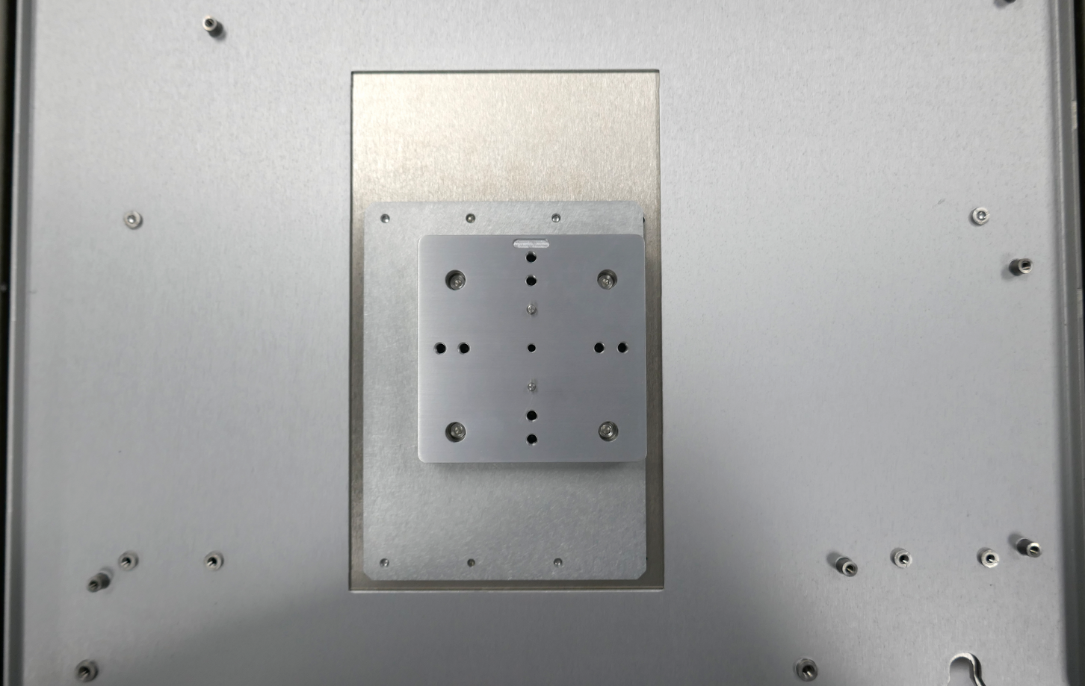
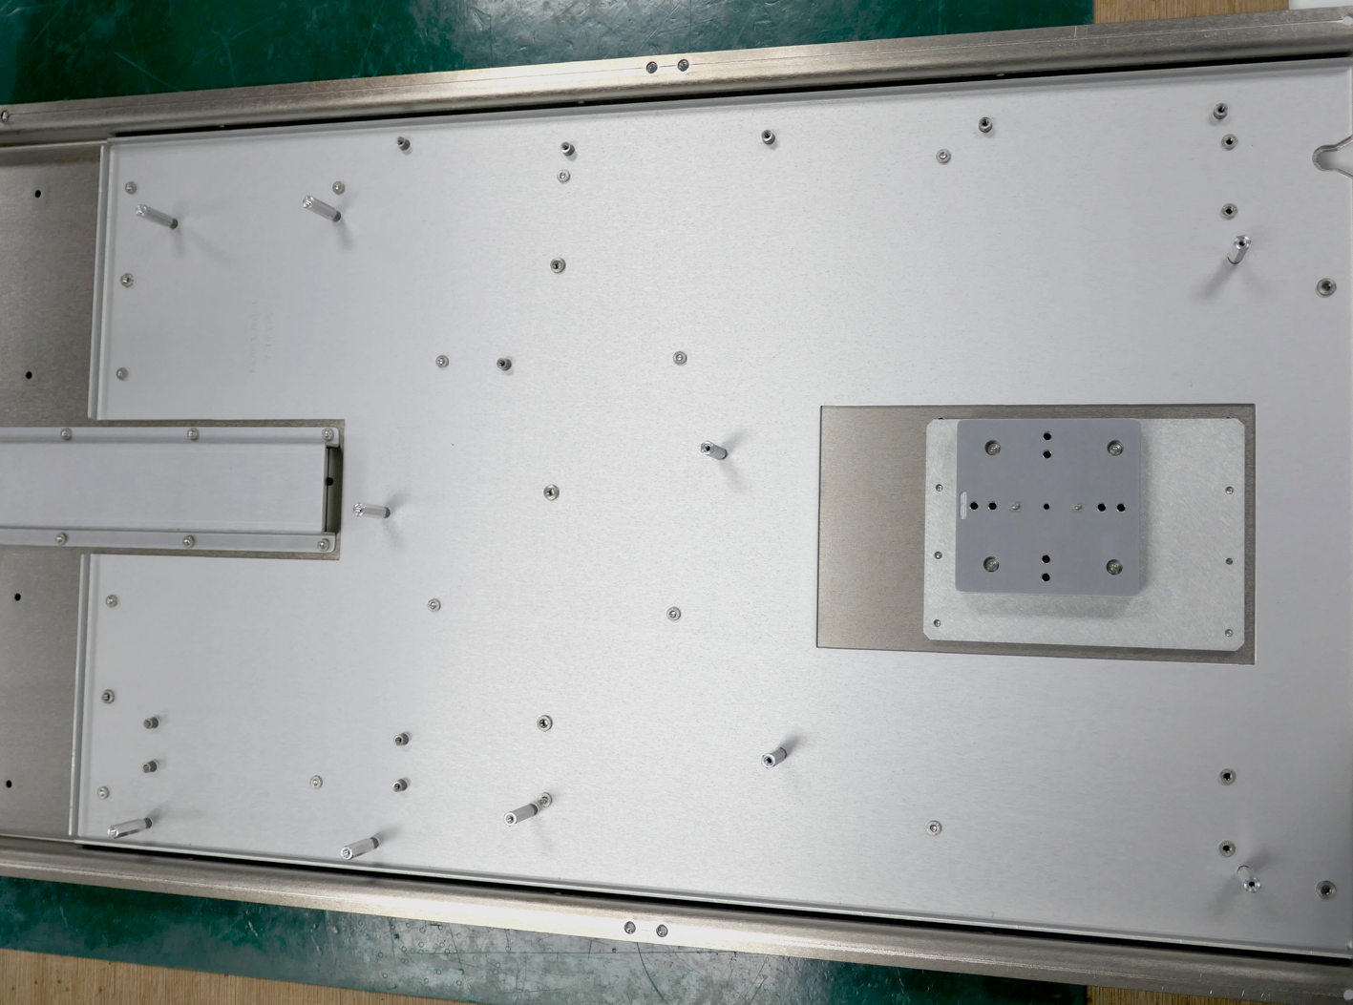
MB Pan Assembly
Mount Universal datum block H32316-001 on conversion datum block J21650-002 using 4x screw A33957-003 torque 4in-lbs.
Ensure correct orientation
3
2
1
4

Slide 4
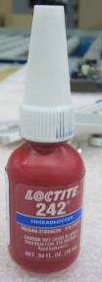
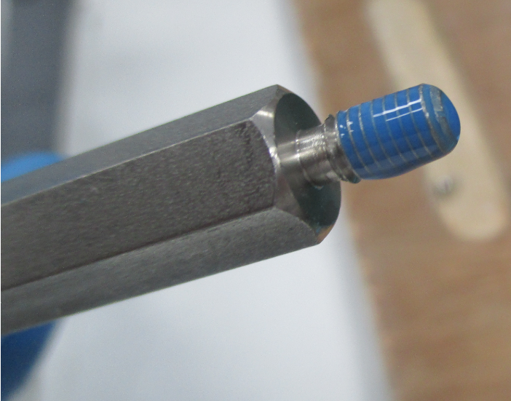
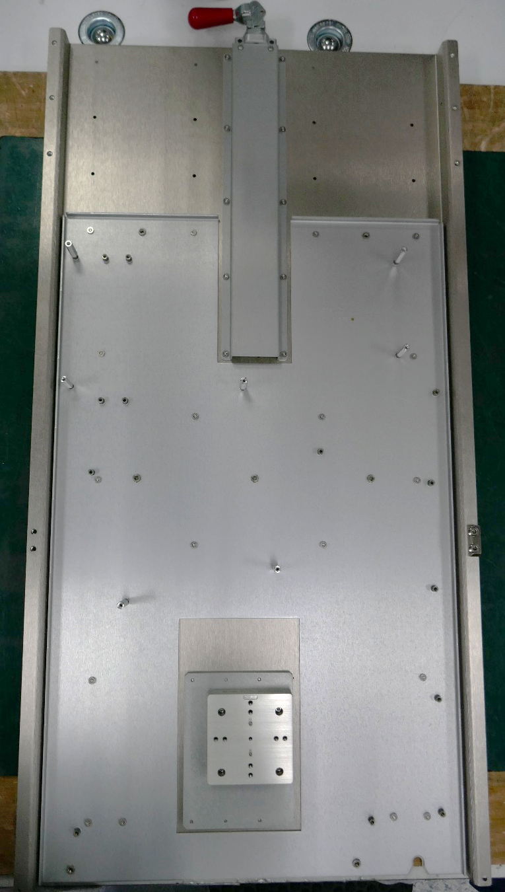
MB Pan Assembly
Apply Loctite 242 to mount 7x Standoffs E46693-001 to MB conversion plate K45091-001 with torque 6in-lbs.
1
3
4
2
5
Loctite level
7
6

